Slide 1
REST APIs
GMES workshop 22/09/21
Corentin Dupont
Waziup e.V.
Technical director
corentin.dupont@waziup.org

Slide 2
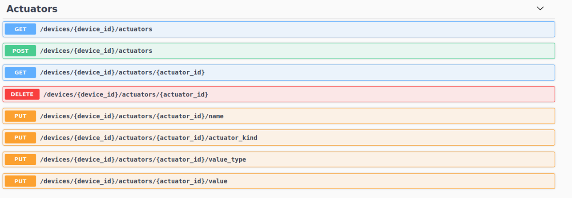
REST API

Slide 3
REST?
REST means: REpresentational State Transfer
Based on HTTP protocol
Everything is a Resource
Resources are identified by URLs
Stateless

Slide 4
REST HTTP Methods
HTTP Method | CRUD Operation | Description
POST | INSERT | Add a new resource
PUT | UPDATE | Modify an existing resource
GET | SELECT | Fetches a resource. The resource is never changed.
DELETE | DELETE | Deletes a resource

Slide 5
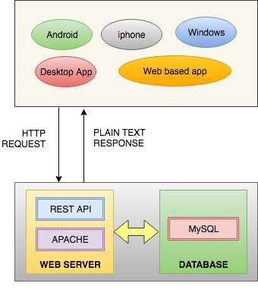
Architecture

Slide 6
HTTP URL
GET https://www.myhost.com/api/v1/user/1/cities
Method
Protocol
Domain
Path

Slide 7
HTTP Rest
GET https://www.myhost.com/api/v1/user/1/cities
API version
Resource
Resource ID

Slide 8
Headers
Header name | Values
Accept | Mime-types: application/json, text/plain
Content-Type | Mime-types: application/json, text/plain
Authorization | Basic, Bearer

Slide 9
HTTP Response Status Code:
Code | Description
1xx | Informational Codes
2xx | Successful Codes
3xx | Redirection Codes
4xx | Client Error Code
5xx | Server Error Codes

Slide 10
Relations
To express relations between resources, use sub-resources:
GET example.com/api/v1/cars/711/drivers/ get all drivers for car 711
GET example.com/api/v1/cars/711/drivers/1 get first driver for car 711

Slide 11
Query string
Filtering:
GET example.com/api/v1/cars?color=blue get all blue cars
GET example.com/api/v1/cars?color=blue&size=mini get mini blue cars
Sorting:
GET example.com/api/v1/cars?sort=+size get all cars, sorted by size
Paging:
GET example.com/api/v1/cars?limit=100 get 100 first cars
GET example.com/api/v1/cars?limit=100&offset=100 get 100 next cars

Slide 12
Some advices
Use Nouns but no verbs in path/URI:
GET example.com/api/v1/getAllUsers WRONG
GET example.com/api/v1/users RIGHT
POST example.com/api/v1/users RIGHT
Use only plural nouns:
GET example.com/api/v1/users -> get all users
GET example.com/api/v1/users/1 -> get user 1

Slide 13
Some advices
GET does not change the state:
GET example.com/api/v1/users/1/activate WRONG
GET example.com/api/v1/users/1?activate WRONG
PUT example.com/api/v1/users/1/activated true RIGHT

